Slide 1
Software Engineering
CSE-3205
Lecture#25

Slide 2
Software cost estimation
Predicting the resources required for a software development process

Slide 3
Fundamental estimation questions
How much effort is required to complete an activity?
How much calendar time is needed to complete an activity?
What is the total cost of an activity?
Project estimation and scheduling and interleaved management activities

Slide 4
Software cost components
Hardware and software costs
Travel and training costs
Effort costs (the dominant factor in most
projects)
  salaries of engineers involved in the project
  Social and insurance costs
Effort costs must take overheads into account
  costs of building, heating, lighting
  costs of networking and communications
  costs of shared facilities (e.g library, staff restaurant, etc.)

Slide 5
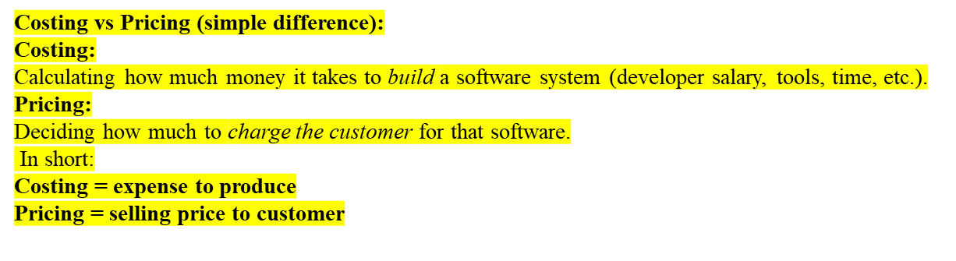
Costing and pricing
Estimates are made to discover the cost, to the developer, of producing a software system
There is not a simple relationship between the development cost and the price charged to the customer
Broader organisational, economic, political and business considerations influence the price charged

Slide 6
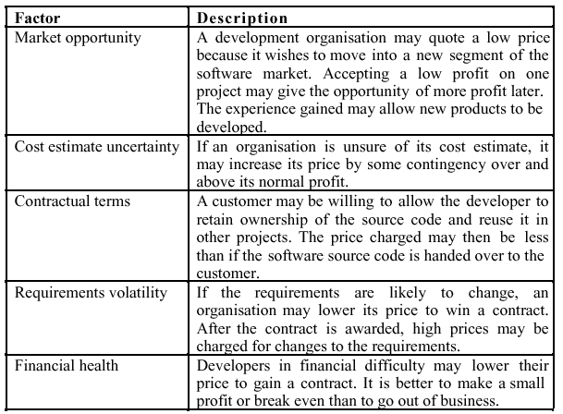
Software pricing factors

Slide 7
Programmer productivity
A measure of the rate at which individual engineers involved in software development produce software and associated documentation
Not quality-oriented although quality assurance is a factor in productivity assessment
Essentially, we want to measure useful functionality produced per time unit

Slide 8
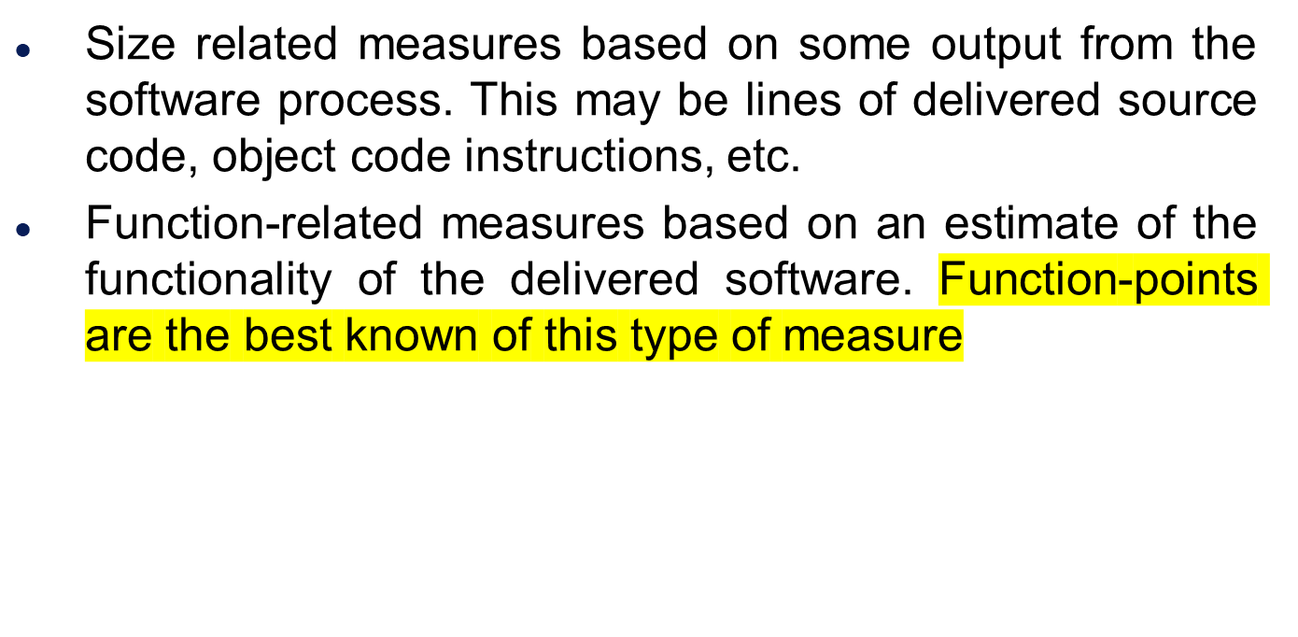
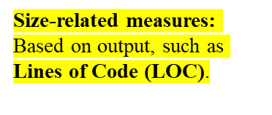
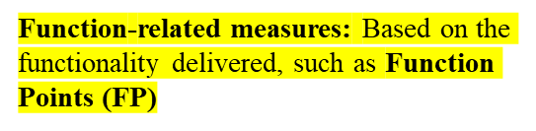
Productivity measures

Slide 9
Measurement problems
Estimating the size of the measure (e.g. how many function points).
Estimating the total number of programmer months that have elapsed.
Estimating contractor productivity (e.g. documentation team) and incorporating this estimate in overall estimate.

Slide 10
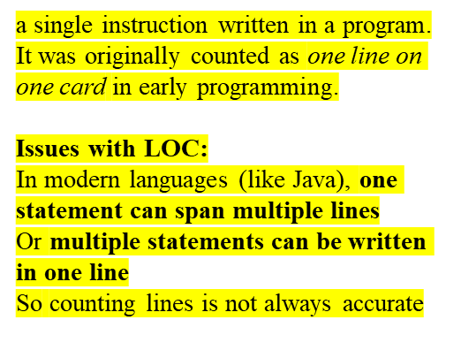
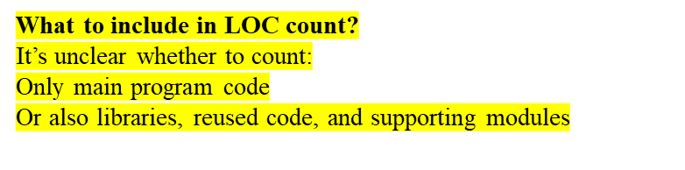
Lines of code
What's a line of code?
  The measure was first proposed when programs were typed on cards with one line per card
  How does this correspond to statements as in Java which can span several lines or where there can be several statements on one line
What programs should be counted as part of the system?
Assumes linear relationship between system
size and volume of documentation

Slide 11
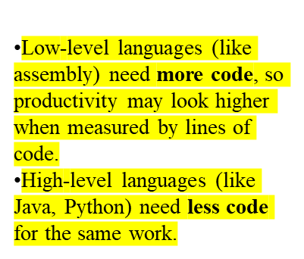
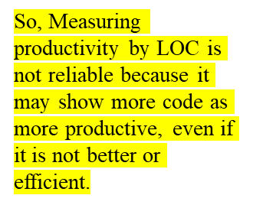
Productivity comparisons
The lower level the language, the more productive the programmer
  The same functionality takes more code to implement in a lower-level language than in a high-level language.
The more verbose the programmer, the higher
the productivity
  Measures of productivity based on lines of code suggest that programmers who write verbose code are more productive than programmers who write compact code.

Slide 12
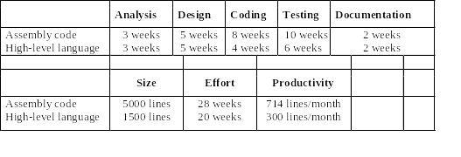
System development times

Slide 13
Function points
Based on a combination of program characteristics
  external inputs and outputs;
  user interactions;
  external interfaces;
  files used by the system.
A weight is associated with each of these and the function point count is computed by multiplying each raw count by the weight and summing all values.

Slide 14
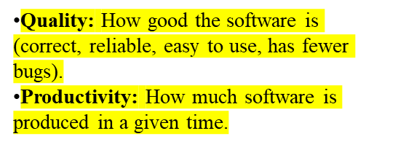
Quality and productivity
All metrics based on volume/unit time are
flawed because they do not take quality into
account.
Productivity may generally be increased at the
cost of quality.
It is not clear how productivity/quality metrics
are related.
If requirements are constantly changing then an approach based on counting lines of code is not meaningful as the program itself is not static;

Slide 15
Estimation techniques
There is no simple way to make an accurate estimate of the effort required to develop a software system
  Initial estimates are based on inadequate information in a user requirements definition;
  The software may run on unfamiliar computers or use new technology;
  The people in the project may be unknown.
Project cost estimates may be self-fulfilling
  The estimate defines the budget and the product is adjusted to meet the budget.

Slide 16
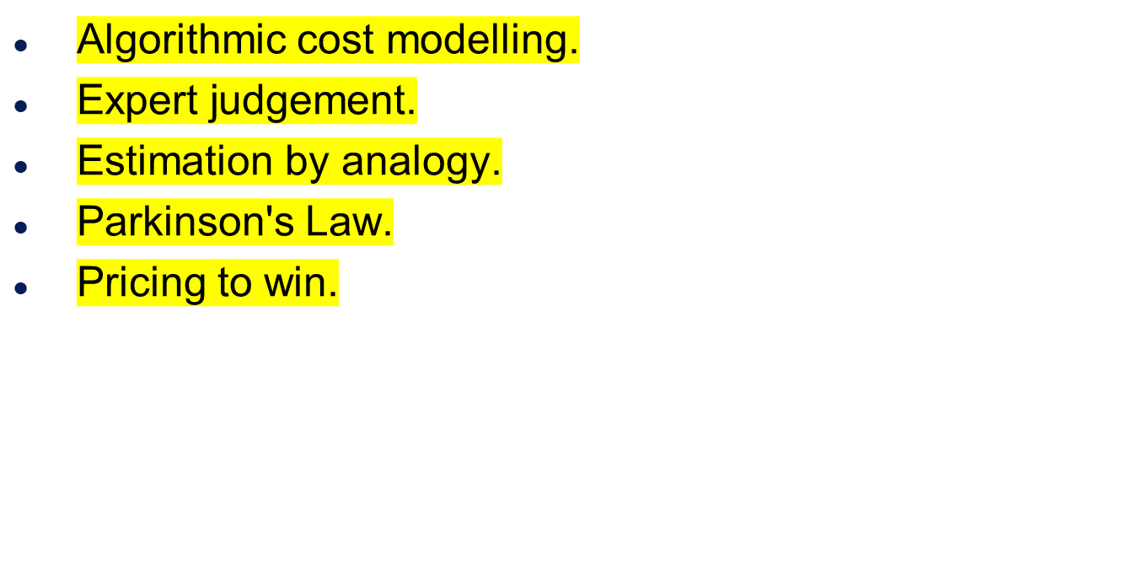
Estimation techniques

Slide 17
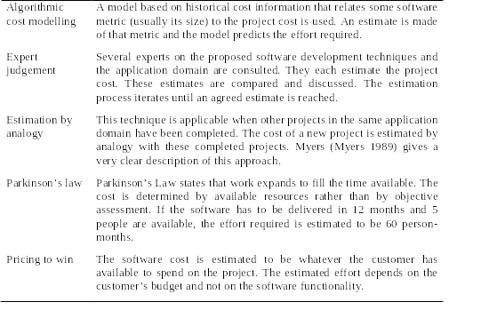
Estimation techniques

Slide 18
Pricing to win
The project costs whatever the customer has to spend on it.
Advantages:
  You get the contract.
Disadvantages:
  The probability that the customer gets the system he or she wants is small. Costs do not accurately reflect the work required.

Slide 19
Top-down and bottom-up estimation
Any of these approaches may be used top-down or bottom-up.
Top-down
  Start at the system level and assess the overall system functionality and how this is delivered through sub-systems.
Bottom-up
  Start at the component level and estimate the effort required for each component. Add these efforts to reach a final estimate.

Slide 20
Top-down estimation
Usable without knowledge of the system architecture and the components that might be part of the system.
Takes into account costs such as integration, configuration management and documentation.
Can underestimate the cost of solving difficult low-level technical problems.

Slide 21
Bottom-up estimation
Usable when the architecture of the system is known and components identified.
This can be an accurate method if the system has been designed in detail.
It may underestimate the costs of system level activities such as integration and documentation.

Slide 22
Estimation methods
Each method has strengths and weaknesses.
Estimation should be based on several methods.
If these do not return approximately the same result, then you have insufficient information available to make an estimate.
Some action should be taken to find out more in order to make more accurate estimates.
Pricing to win is sometimes the only applicable method.

Slide 23
Pricing to win
This approach may seem unethical and un-businesslike.
However, when detailed information is lacking it may be the only appropriate strategy.
The project cost is agreed on the basis of an outline proposal and the development is constrained by that cost.
A detailed specification may be negotiated or an evolutionary approach used for system development.

Slide 24
Estimation accuracy
The size of a software system can only be known accurately when it is finished.
Several factors influence the final size
  Use of COTS and components;
  Programming language;
  Distribution of system.
As the development process progresses then the size estimate becomes more accurate.

Slide 25
The COCOMO model
An empirical model based on project experience.
Well-documented, ‘independent’ model which is not tied to a specific software vendor.
Long history from initial version published in 1981 (COCOMO-81) through various instantiations to COCOMO 2.
COCOMO 2 takes into account different approaches to software development, reuse, etc.

Slide 26
The COCOMO model
The overall resources for software project must be estimated:
  development costs (i.e. programmer-months)
  development interval
  staffing levels
  maintenance costs
General approaches include:
  expert judgment (past experience times judgmental factor accounting for differences).
  algorithmic (empirical models).

Slide 27
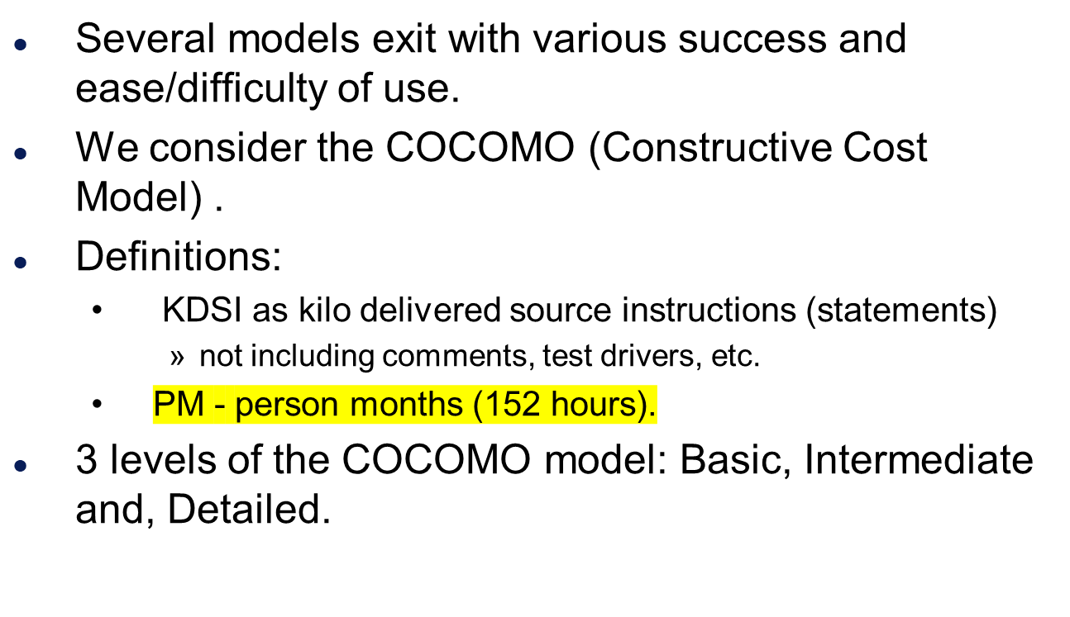
The COCOMO model

Slide 28
The COCOMO model
Model 1: The Basic COCOMO Model
  Computes software development effort/Cost as
    function of program size expressed in estimated lines of code (LOC)
Model 2: The Intermediate COCOMO Model
  Computes software development effort/Cost as
    function of program size and
    a set of cost drivers that include subjective assessments of product, hardware, personnel, and project attributes.

Slide 29
The COCOMO model
Model 3: The Advanced COCOMO Model
Incorporates all characteristics of the intermediate version
    an assessment of the cost driver’s impact on each step (analysis, design etc.) of the software engineering process.

Slide 30
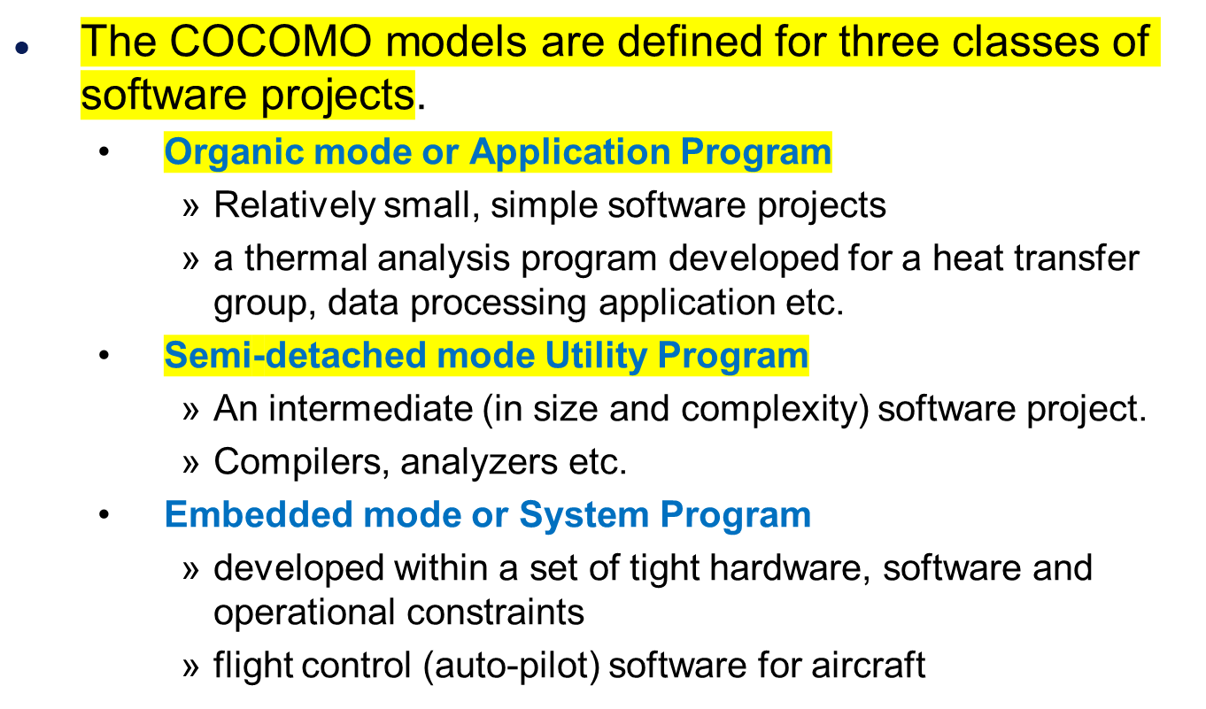
The COCOMO model

Slide 31
Organic mode / Application Program
Apply the following formulae to get rough estimates:
  PM = 2.4 x (KDSI)^{1.05}
  T_{DEV} = 2.5 x (PM)^{0.38}
  N = PM/ T_{DEV}
PM : Effort applied (in person-months)
T_{DEV} : Development time (in months)
N : Number of people employed
KDSI : kilo delivered source instructions
Organic mode project, 32KLOC
  PM = 2.4 x (32) ^{1.05} = 91 person months
  TDEV = 2.5 x (91) ^{0.38} = 14 months
  N = 91/14 = 6.5 people

Slide 32
Semi-detached mode / Utility Program
Apply the following formulae to get rough estimates:
  PM = 3.0 x (KDSI)^{1.12}
  T_{DEV} = 2.5 x (PM)^{0.35}
  N = PM/ T_{DEV}
PM : Effort applied (in person-months)
T_{DEV} : Development time (in months)
N : Number of people employed
KDSI : kilo delivered source instructions

Slide 33
Embedded mode / System Program
Apply the following formulae to get rough estimates:
  PM = 3.6 x (KDSI)^{1.20}
  T_{DEV} = 2.5 x (PM)^{0.32}
  N = PM/ T_{DEV}
PM : Effort applied (in person-months)
T_{DEV} : Development time (in months)
N : Number of people employed
KDSI : kilo delivered source instructions
Embedded mode project, 128KLOC
  PM = 3.6 x (128)^{1.2} = 1216 person-months
  TDEV = 2.5 x(1216)^{0.32} = 24 months
  N = 1216/24 = 51

Slide 34
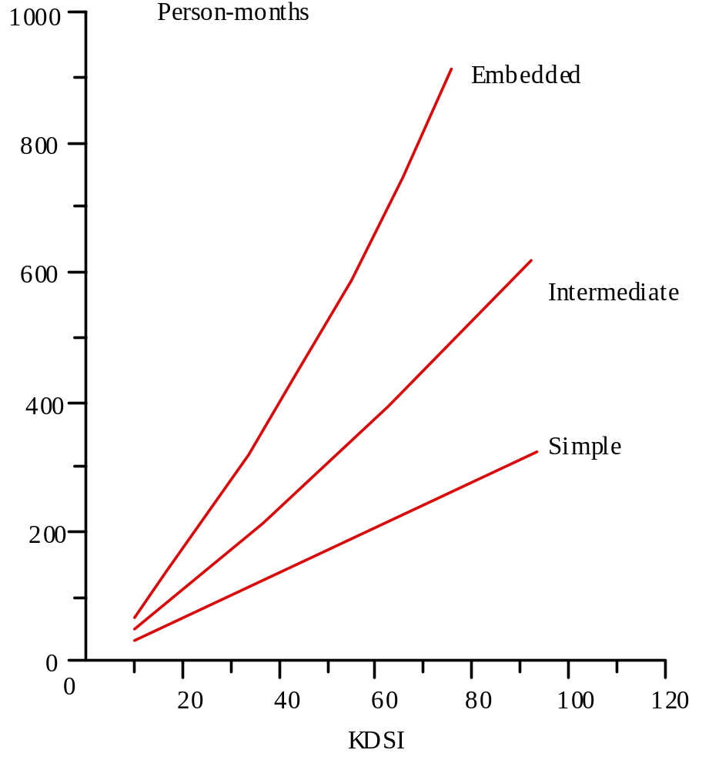
Effort estimates

Slide 35
END

